Slide 1
Car Price Prediction on Formerly owned vehicle using Machine Learning Model.
Presented By:
Abhishek Lal – C23039

Slide 2
OBJECTIVE
Which features are the strongest predictors for Price?
Which model can predict better if a new dataset of similar kind is given ?

Slide 3
DATA DESCRIPTION
Target Variable:
Selling Price
Predictor Variables:
Car Name
Year
Kms_Driven
Fuel_Type
Seller_Type
Transmission
Owner
Day Mins
Day Calls
Monthly Charge
Overage Fee
Roam Mins

Slide 4
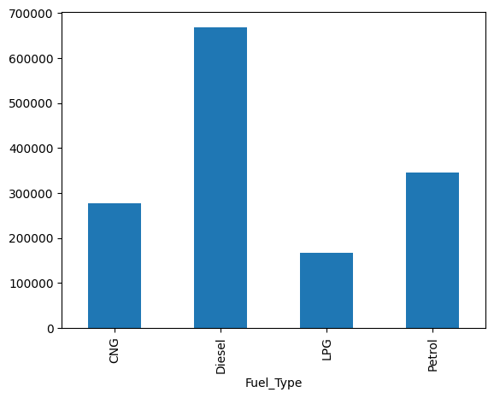
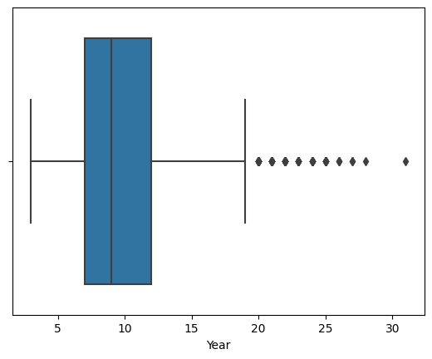
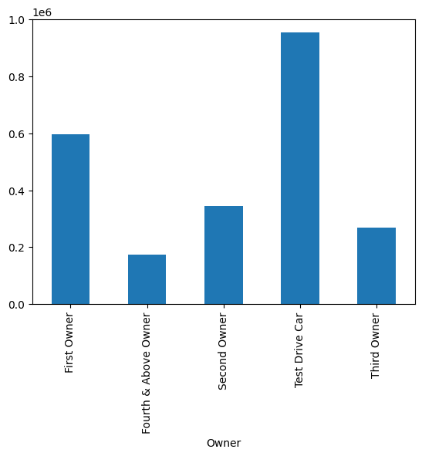
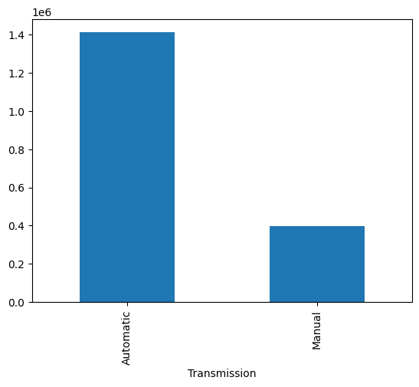
EXPLORATORY DATA ANALYSIS

Slide 5
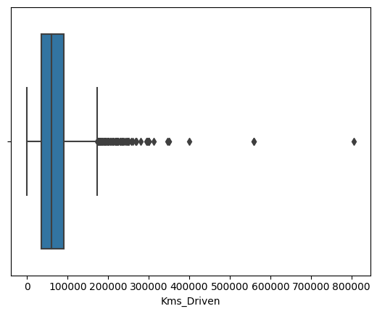
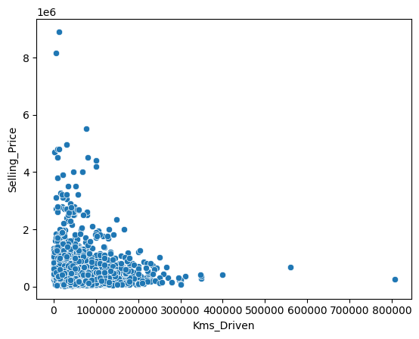
EXPLORATORY DATA ANALYSIS

Slide 6
FEATURE ENGINEERING
Indexing Categorical Variables
Encoding Categorical Variables.
Vectorising
Scaling

Slide 7
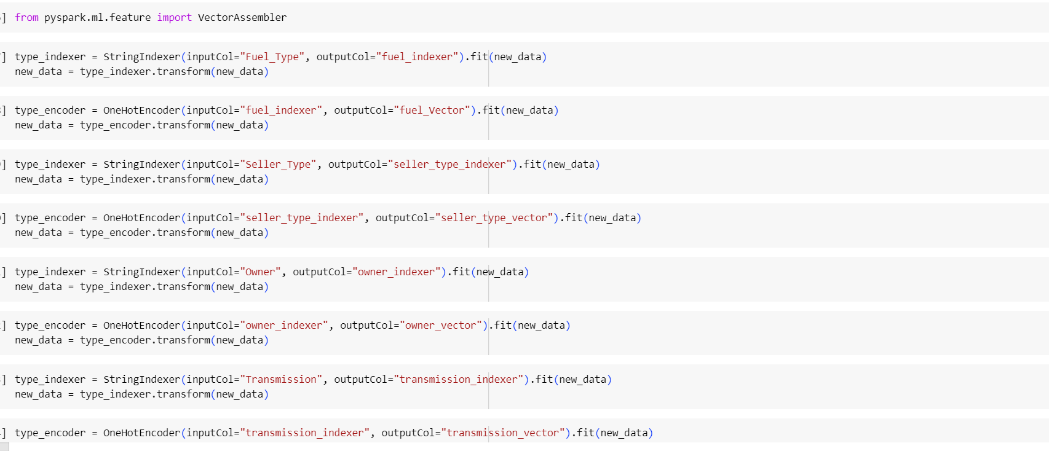
FEATURE ENGINEERING
Scaling of features has been done here after encoding and assembling.

Slide 8
MODELLING
Liner RegressionPipeline
Decision Tree Regression Pipeline

Slide 9
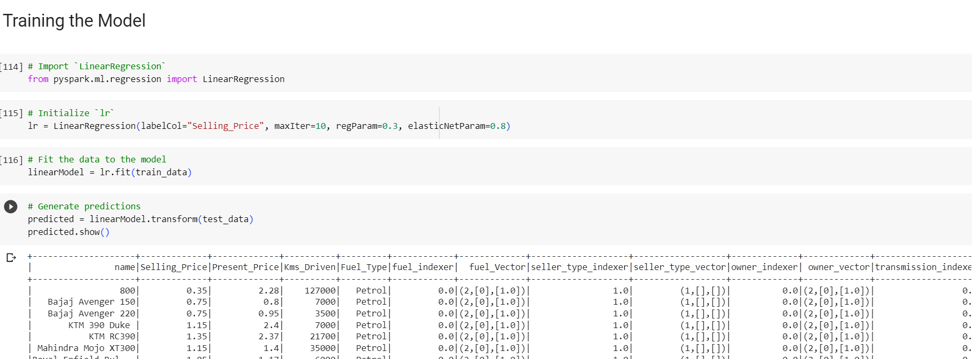
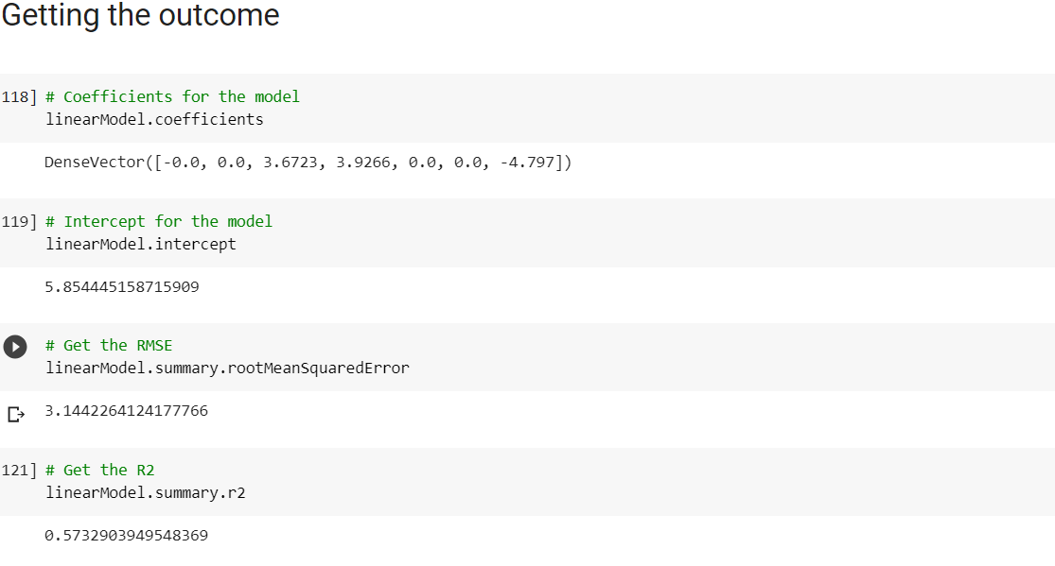
LINEAR REGRESSION

Slide 10
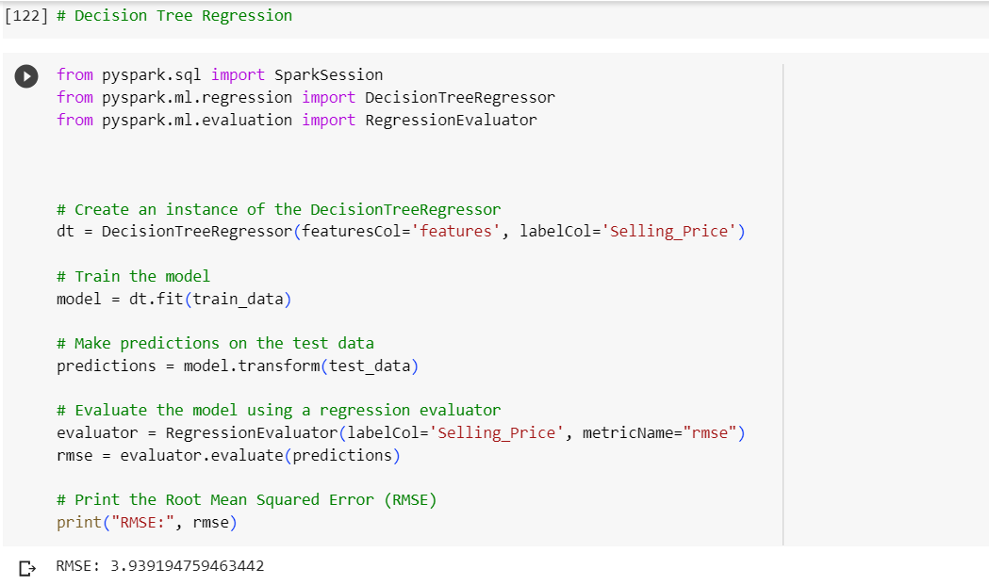
Decision Tree Regresion

Slide 11
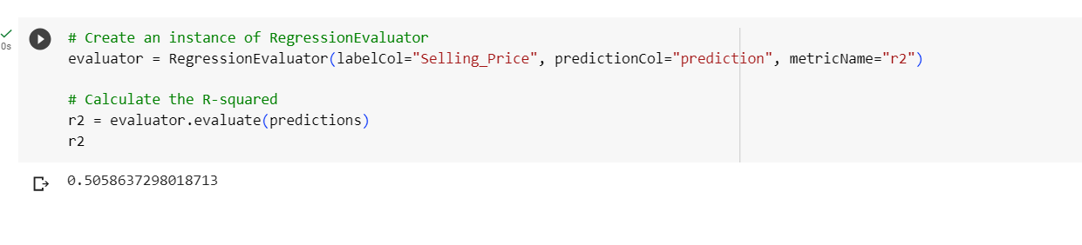
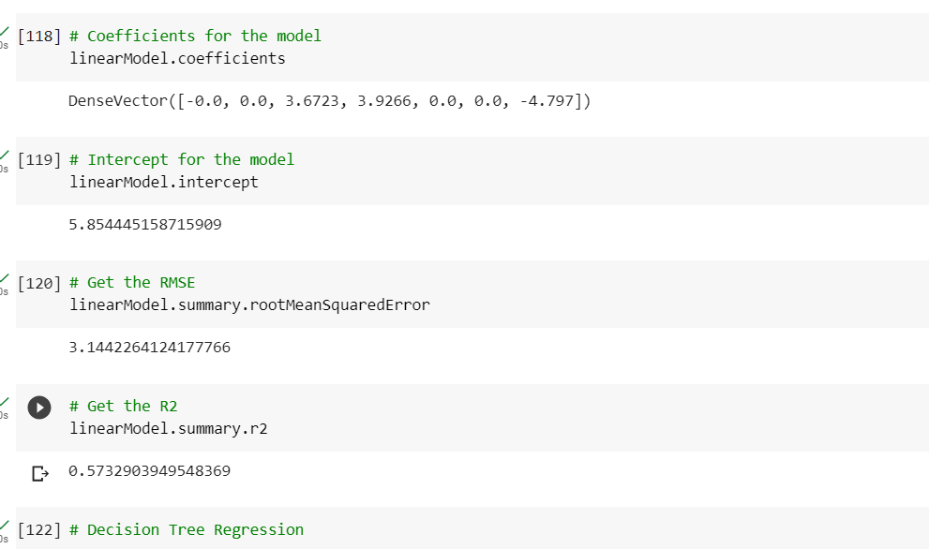
MODEL COMPARISON

Slide 12
CONCLUSION
Decision Tree has given us better result which is just marginally better than Linear Regression.
However the r2 score is better in case of Decision Tree.
Hence, Decision Tree can be used to predict selling price of used car.

